Slide 1



ALNBS End User
Process Training
Sahitya Reddy
October 2014

Slide 2
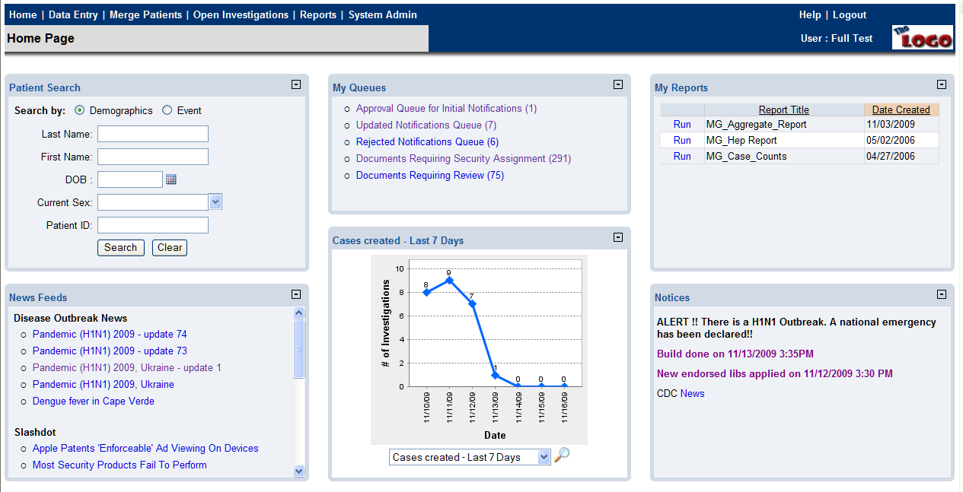
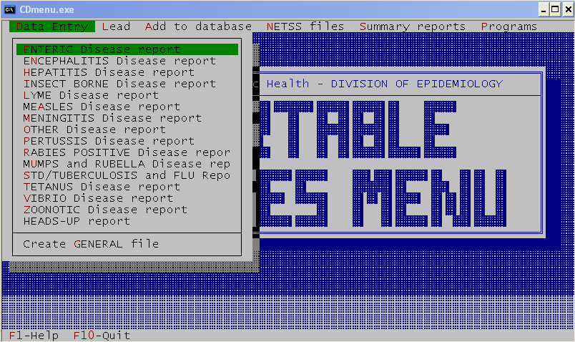
What is NEDSS, NBS or ALNBS?
New secure web-based electronic disease reporting system

Slide 3
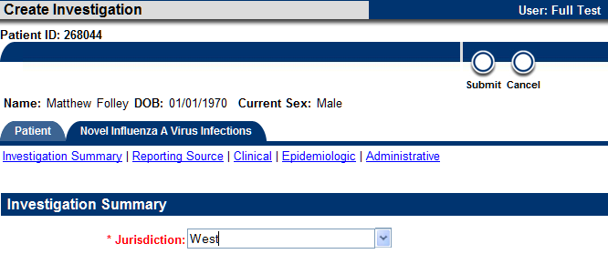
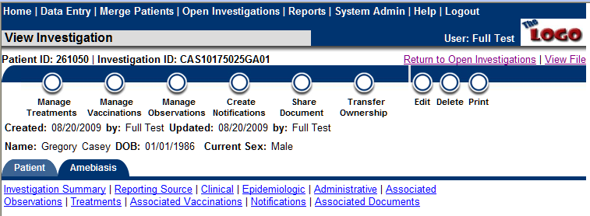
ALNBS

Slide 4
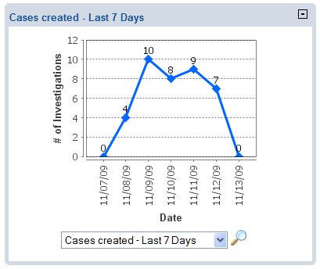
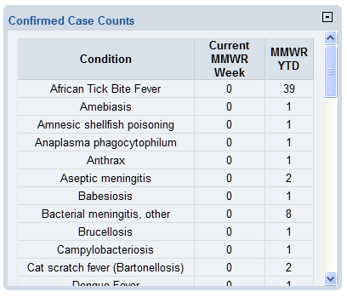
ALNBS - Reporting

Slide 5
ALNBS
Why ALNBS (General Benefits)?
  Electronic real-time reporting of information for public health action
  Earlier Detection of Outbreaks
  Allow Public Health to make better decisions
  Reduce duplicate data entry
  Eliminate paper reporting
  Electronic Laboratory Reporting (ELR)

Slide 6
NBS Terminology
Observation = Lab Report or a Morbidity Report
Document = Observations and Case Reports
Notification = Process performed by the investigator to notify the State Disease Program of a completed investigation
Queues = Areas within the system to help with workflow (Like an electronic “In Box”)
Event = Investigation, Lab Report, Morbidity Report, Treatment, Vaccination
Jurisdiction = County responsible for a case, also the County that the case is counted in for MMWR reporting
Investigator = Person primarily responsible for collecting the investigation data.

Slide 7
NBS Functions
VARICELLA PAM
VPD PAM
GCD PAM
BMIRD PAM
HEPATITIS PAM
TB PAM
Security
Core Demographics
Notifiable Disease
Investigation
Messaging
Reporting

Slide 8
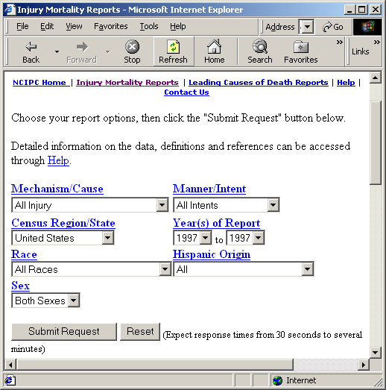
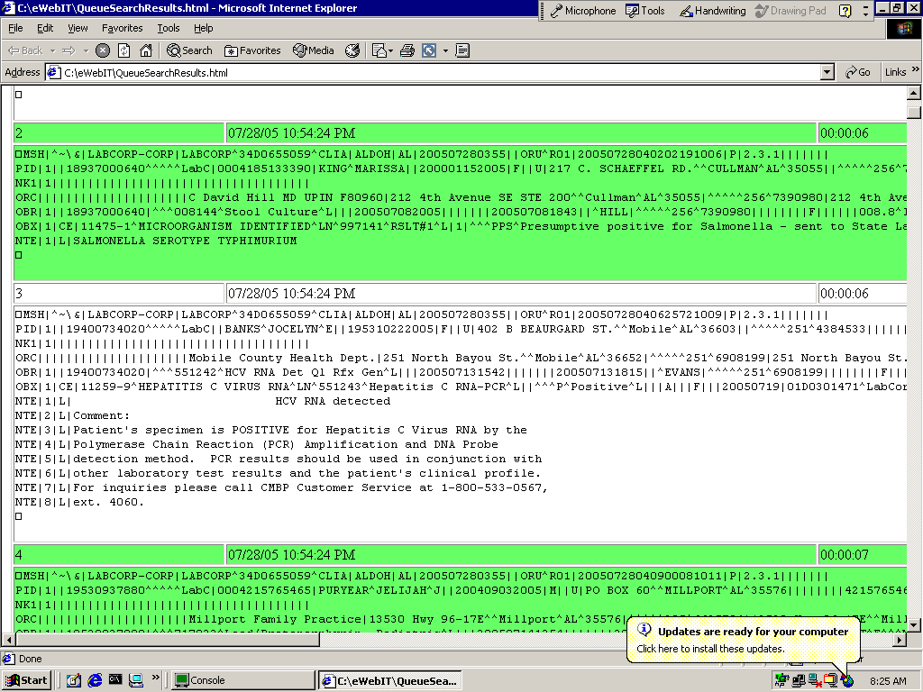
Where does the data come from?
State Health
Department
ICP & Lab Tech
(Hospital)
County Health
Department
Security
Integrated State
/ Local Data
Repository
Private Labs & Hospital Labs
(ELR HL7)

Slide 9
NBS Security Overview
For what geographic areas can the user access data?
What program areas is the user allowed to access?
General Communicable
Immunization
STD
PH Area
County
The data and functions a user can access are defined in 4 dimensions.
An audit trail of user actions is in the database.
ALNBS Security
Person
Investigation
Morbidity Report
View
Edit
Delete
What forms can the
user work with?
What can the user do?

Slide 10


Electronic Disease Reporting using the ALNBS
A lab tech posts a final Positive Reportable result into their LIS
ELR from a Lab
The patient demographics and test result information are electronically routed to the appropriate disease Program Area and Jurisdiction via ALNBS.
The disease surveillance caseworker at the County Health Dept. reviews the lab result and initiates an Investigation
Paperless Electronic Data Flow!!!
County ALNBS User
If the investigation meets Case Definition a Notification is created and sent electronically to the State Health Dept for review
CDC
Once approved, the Investigation is sent to the CDC
The state disease program staff reviews the Investigation and either approves or rejects it
State ALNBS User
Notes:
Queues renamed from Observations to Documents because now they would contain
Both observations and case reports that have been imported from another state.

Slide 11




MONITOR, INVESTIGATE and REPORT NNDs in ALNBS
New Lab / Morbidity Reports
Scenario 1
Mark as Reviewed
Inbox
Scenario 3
Create Notification
Marked As Reviewed
Documents Requiring
Review Queue
Filed
New Lab / Morbidity Reports
Scenario 2
Transfer Ownership
Inbox
Inbox
Transfer Ownership
Documents Requiring
Review Queue of
transferred county /PA
CDC
Documents Requiring
Review Queue
Approve
New Lab / Morbidity Reports
Close Investigation
and create Notification
Inbox
In Progress
State Inbox 1
Returned
Create and Open
Investigation
Reject
Documents Requiring
Review Queue
Open
Investigations
Rejected Notifications
Queue
Approval for Initial
Notifications Queue

Slide 12
Where are we now?
  Reporting from all 11 Public Health Areas for EPI, VPD and TB.
  Manually entered lab reports from USAMC and EAMC to ALNBS
  Labcorp, Mayo, State Lab, Medtox and ARUP ELR into “Production” ALNBS
  About 140 Active NBS Users
  Began collecting data in 2004 (Mobile)
  Jefferson began data collection in 2006
  First year of complete statewide data 2007
  21,000 Case Investigations
  410,000 Lab Results
  Average receipt of approximately 300 ELRs per day
  Daily extract of Lead ELR data into Stellar
  Daily extract of HIV ELR data into eHARS
  Spatial Pattern of Disease Analysis tool (GIS) in Production
  NBS Version 3.1.3 in production

Slide 13
What next?
  Quarterly On-going Training/Continuing Education
  Other ELR Interfaces (Quest, Hospitals)
  Contact Tracing
  Public Health Case Reporting
  NBS 4.0 : Disease Module Builder (DMB).

Slide 14
What is a DMB?
  The system components that enable the generation and maintenance of Disease Modules based on the needs of implementation sites:
  Generation and configuration of disease specific electronic forms
  Administration of disease specific vocabulary based on CDC PHIN Vocabulary Access and Distribution System (VADS) content
  Implementation of disease specific validations and user interface behaviors
  Configuration of flat files containing disease specific data for analysis in the Reporting Database
  Ability to extract data elements needed for disease reporting to CDC based on the message Structure Specification for National Condition Reporting v.2 and disease specific CDC PHIN Case Notification Implementation Guides
  Ability to version, import and export disease modules to promote sharing amongst implementation sites
  Allow implementation sites to integrate Disease Modules with NBS Enterprise Services
  Allow implementation sites to port existing disease module data to new disease module implementation

